Slide 1
Extend ID3 decision tree algorithm using PCA
Amirkhosro Vosughi
CptS 570 Project, Fall 2017
Notes:
Template-Primary on 201-shield

Slide 2
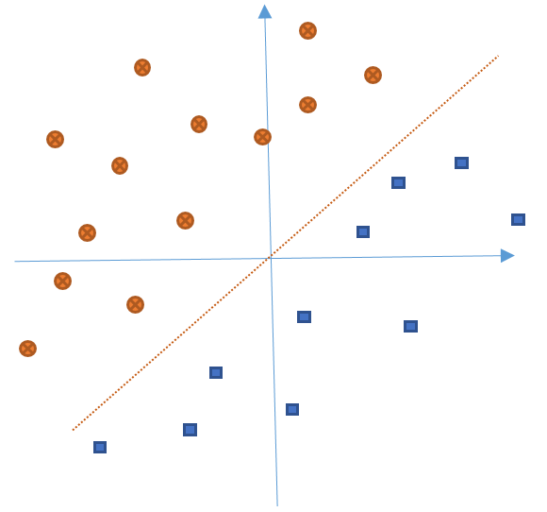
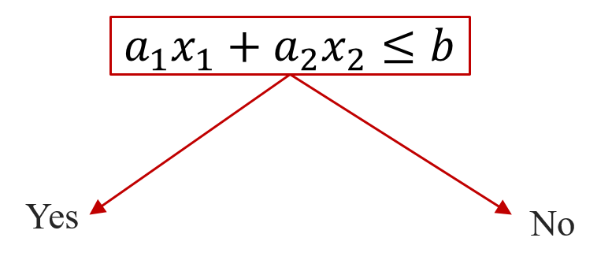
Motivation
  Modify ID3 to have better performance in sense of depth
  Assumption: For Binary classification with continuous features
  Result presented for two continuous features for simplicity: Extendable to as many continuous features
  Use linear combination of features in each node of ID3
Notes:
Template-Primary on 201-shield

Slide 3
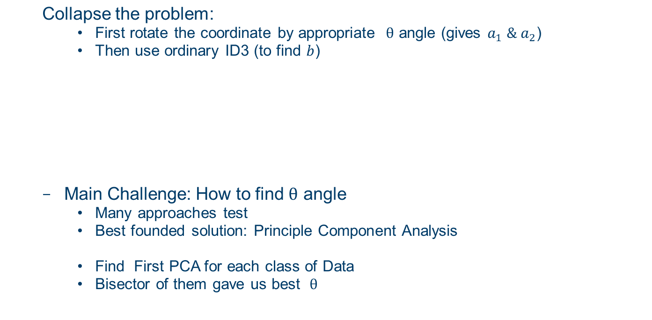
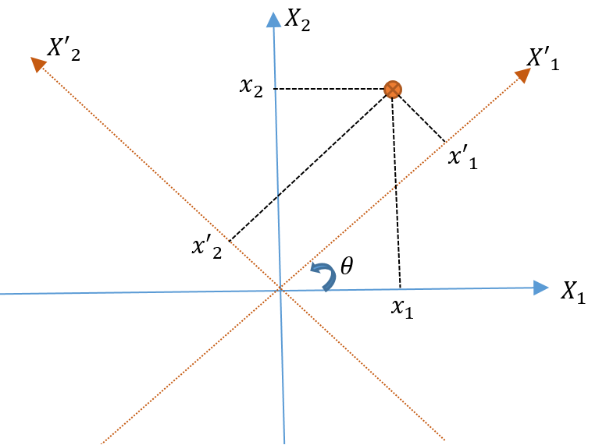
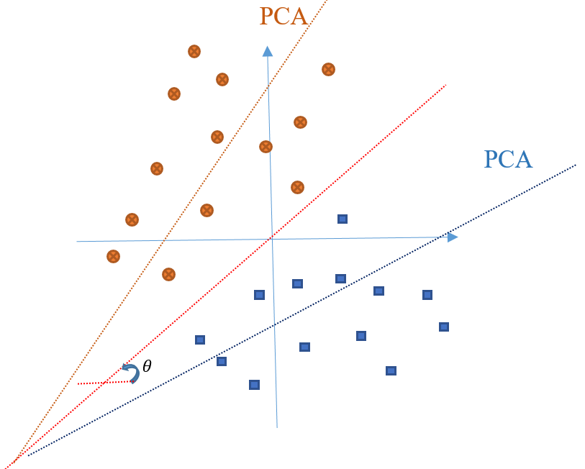
Solution
Notes:
Template-Primary on 201-shield

Slide 4
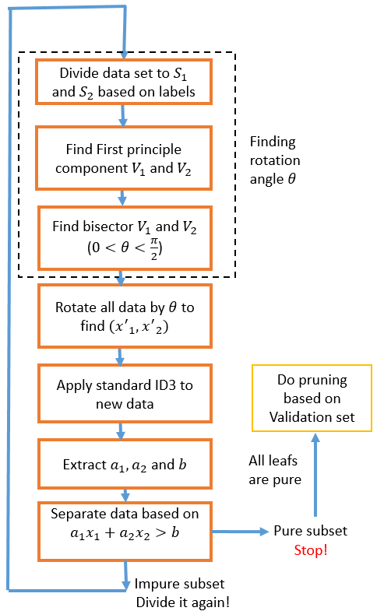
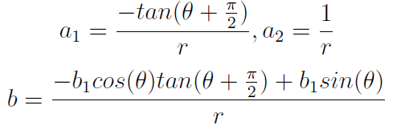
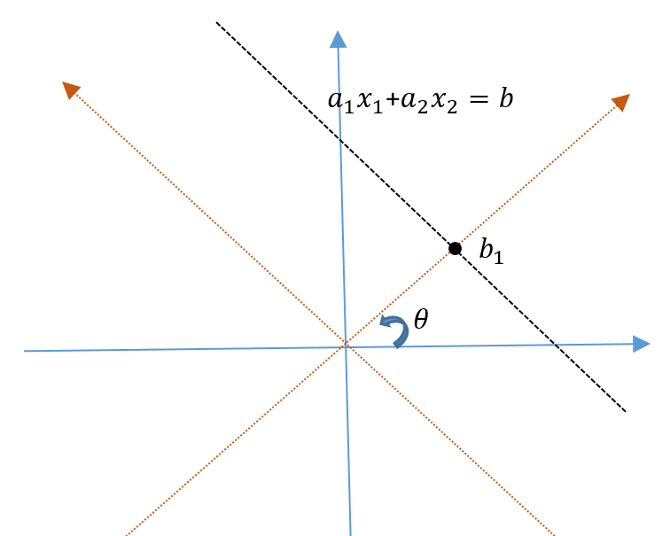
Overview
Notes:
Template-Primary on 201-shield

Slide 5
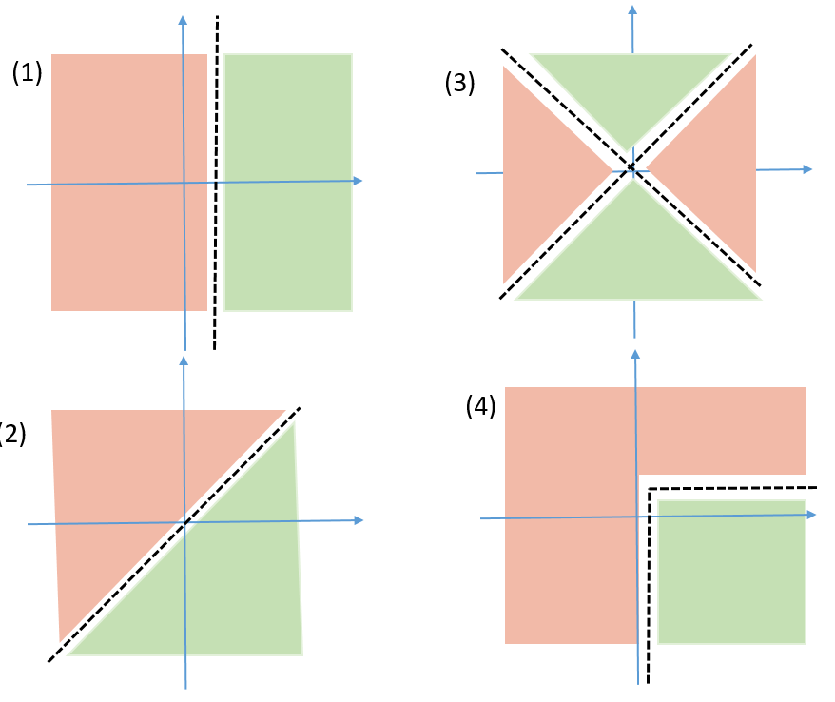
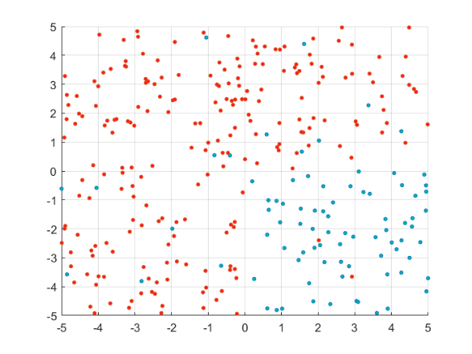
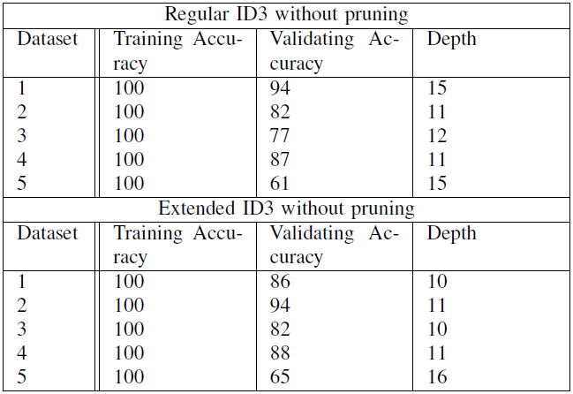
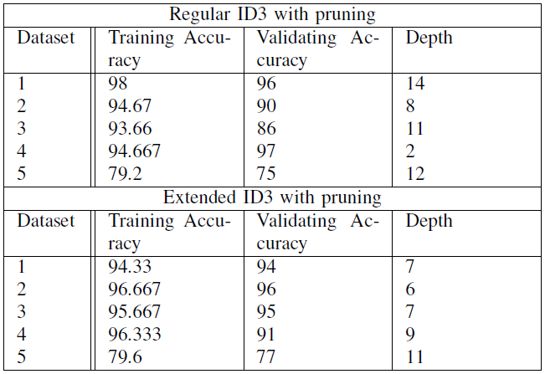
Results
  (5) Dataset:
  UCI Machine Learning Repository
  Blood Transfusion Service Center
  Binary output → does person donate blood this month
  2 continuous features → 1. months from first donation, 2. total # donation
Notes:
Template-Primary on 201-shield

Slide 6
Question
Thank You

